Slide 1

An Image Analysis Pipeline to Extract Diameter from 3D Muscle Fiber Images
Dylan Mendonca
MEng Project, McGuigan Lab
3-December-2020
Notes:
Introduce
- Name, University, labs, thesis project
Why?
- Interesting approach compared to commonly used DCNN
Outline
I will start with an overview, then dive into algorithm stuff, then some results
Note that the scope of this project was primarily focused on model and algorithm development
Ask questions, feel free

Slide 2
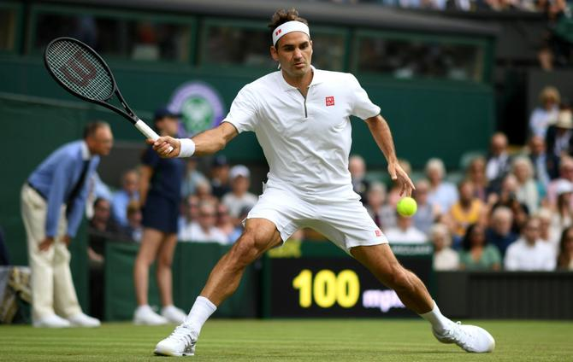
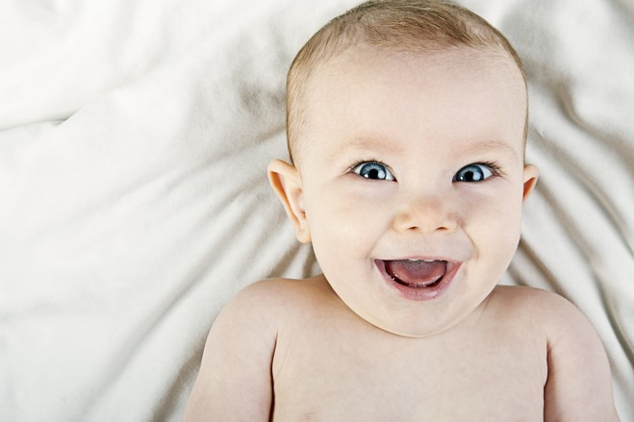

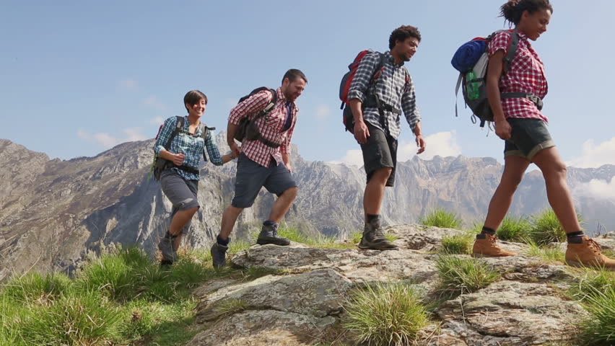
We are made of muscles!
Notes:
We are made of muscles, they’re h

Slide 3
Muscle regeneration is a very important area of biological research
~10% reduction in sarcopenia could save $1.1 billion/year¹
Poor muscle health can lower lifespan²
~22 people per 100,000 suffer from muscle disorders³
¹ Kalyani, R. R., Corriere, M., & Ferrucci, L. (2014). Age-related and disease-related muscle loss. Diabetes & endocrinology, 2(10), 819–829.
² Demontis, F., Piccirillo, R., Goldberg, A. L., & Perrimon, N. (2013). The influence of skeletal muscle on systemic aging and lifespan. Aging Cell, 12(6), 943–949.
³ Theadom A, Rodrigues M, Roxburgh R, Balalla S, Higgins C, Bhattacharjee R, Jones K, Krishnamurthi R, Feigin V. (2014). Prevalence of Muscular Dystrophies: A Systematic Literature Review. Neuroepidemiology, 43, 259-268.
Notes:
THERE ARENT MANY SOLUTIONS

Slide 4
Muscle regeneration is a very important area of biological research
~10% reduction in sarcopenia could save $1.1 billion/year¹
Poor muscle health can lower lifespan²
~22 people per 100,000 suffer from muscle disorders³
There aren’t many good solutions for these problems!
¹ Kalyani, R. R., Corriere, M., & Ferrucci, L. (2014). Age-related and disease-related muscle loss. Diabetes & endocrinology, 2(10), 819–829.
² Demontis, F., Piccirillo, R., Goldberg, A. L., & Perrimon, N. (2013). The influence of skeletal muscle on systemic aging and lifespan. Aging Cell, 12(6), 943–949.
³ Theadom A, Rodrigues M, Roxburgh R, Balalla S, Higgins C, Bhattacharjee R, Jones K, Krishnamurthi R, Feigin V. (2014). Prevalence of Muscular Dystrophies: A Systematic Literature Review. Neuroepidemiology, 43, 259-268.
Notes:
THERE ARENT MANY SOLUTIONS

Slide 5
MEndR is a 3D model that can help drive discovery in muscle regeneration
Notes:
Muscle Endogenous Repair Model is an in vitro 3D biological model that can recapitulate muscle fiber morphology

Slide 6
MEndR is a 3D model that can help drive discovery in muscle regeneration
M
uscle
End
ogenous
R
epair
Model
Notes:
Muscle Endogenous Repair Model is an in vitro 3D biological model that can recapitulate muscle fiber morphology

Slide 7
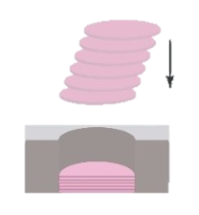
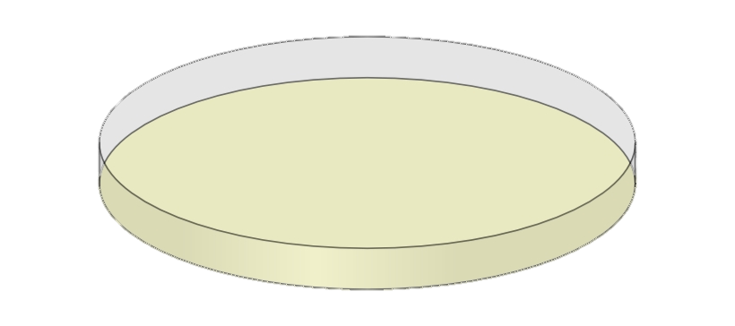
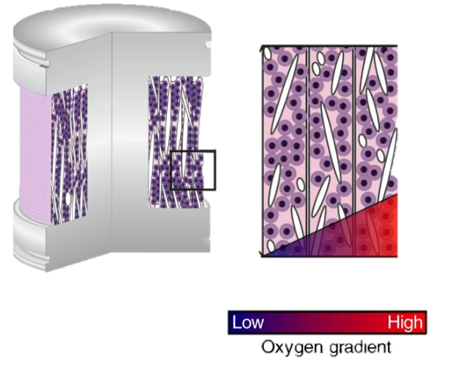
MEndR is a 3D model that can help drive discovery in muscle regeneration
2D Models
3D Models
Fig 1
Fig 2
Fig 1: Kundu, S., Reis, R. Biomaterials for 3D Tumor Modeling (2020)
Fig 2: Rodenhizer, D. et al. A three-dimensional engineered tumour for spatial snapshot analysis of cell metabolism and phenotype in hypoxic gradients (2016). Nat. Mater. 15, 227–234
Notes:
Muscle Endogenous Repair Model is an in vitro 3D biological model that can recapitulate muscle fiber morphology

Slide 8
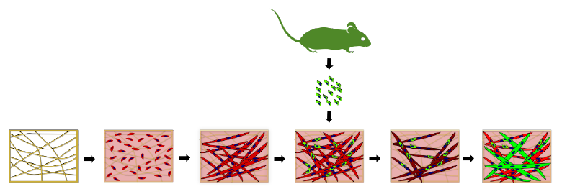


MEndR is a 3D model that can help drive discovery in muscle regeneration
Grow muscle cells in 3D scaffold
Height
Fard, A. R. M. Development of a 96-well Platform to Increase Throughput of a Muscle Endogenous Repair Model (2020). University of Toronto

Slide 9
MEndR is a 3D model that can help drive discovery in muscle regeneration
Add mouse stem cells
Height
Fard, A. R. M. Development of a 96-well Platform to Increase Throughput of a Muscle Endogenous Repair Model (2020). University of Toronto

Slide 10
MEndR is a 3D model that can help drive discovery in muscle regeneration
Injure the muscle and add drug
Height
Fard, A. R. M. Development of a 96-well Platform to Increase Throughput of a Muscle Endogenous Repair Model (2020). University of Toronto

Slide 11
MEndR is a 3D model that can help drive discovery in muscle regeneration
Take picture and analyze
Height
Fard, A. R. M. Development of a 96-well Platform to Increase Throughput of a Muscle Endogenous Repair Model (2020). University of Toronto

Slide 12
MEndR is an effective intermediate compared to alternative methods
2D Models
MEndR
ANIMAL MODELS
Biologically representative
Accessibility

Slide 13
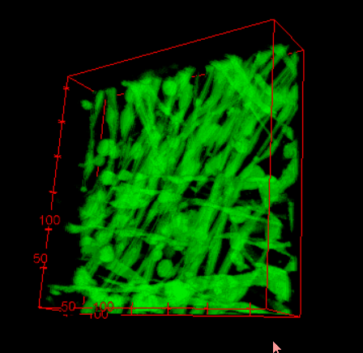
Image analysis in MEndR is a bottleneck
Notes:
Takes long to analyze
It will be the bottleneck
Forward looking
Unaligned!!

Slide 14
Computational algorithms can help!
Allow for quick, repeatable measurements
Computational models might have inherent biases, but these can be quantified
Algorithms can access information that is difficult to obtain manually

Slide 15

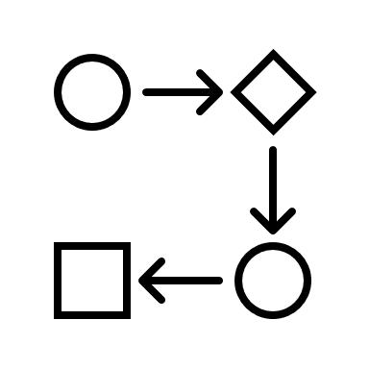

Project Goals
Input
Image Analysis Pipeline
Output
A MEndR Image
Combination of techniques
Diameter distribution
Notes:
Build an image analysis pipeline that takes an input MEndR image and extracts useful information indicating the health of the muscle fibers
I chose to focus on fiber diameter
USE A VISUAL

Slide 16
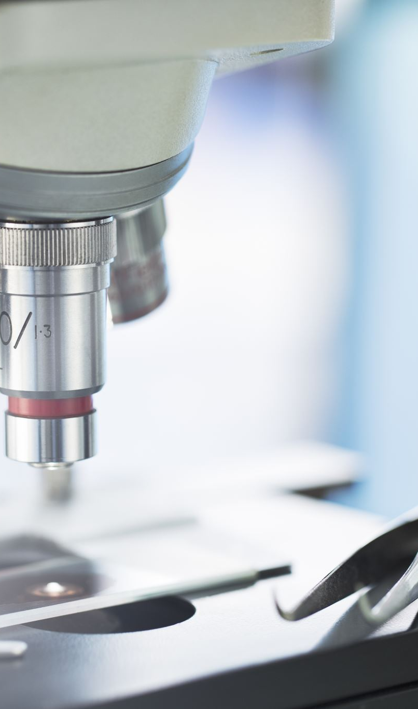
Cellular Image Analysis
Notes:
This problem has never been done in 3D on muscle fiber

Slide 17
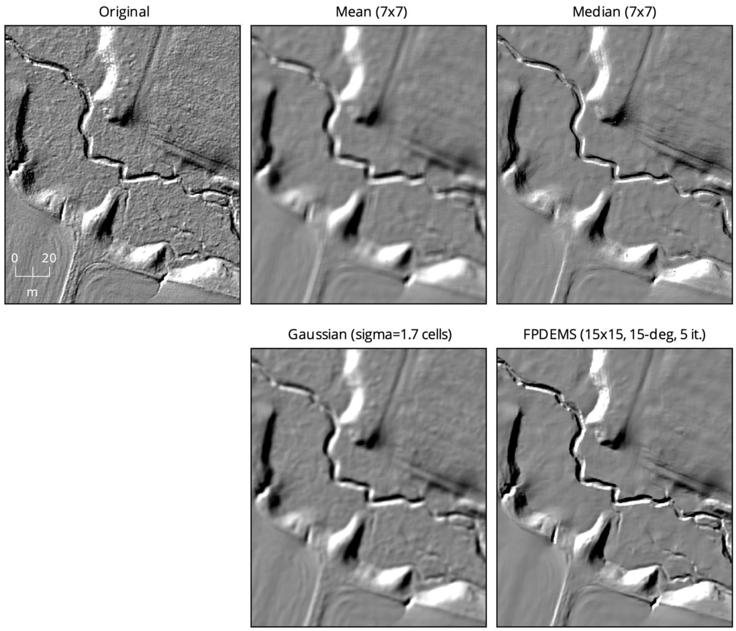
Cellular image analysis has a workflow
Image Analysis Step
Pre-Processing
Challenges
Low resolution
Uneven illumination
High noise
Lindsay, J. B., Francioni, A., Cockburn, J. M. LiDAR DEM Smoothing and the Preservation of Drainage Features (2019). Remote Sensing, 11(16), 1926

Slide 18
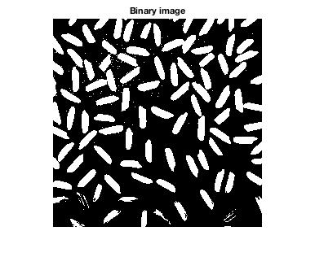
Cellular image analysis has a workflow
Image Analysis Step
Pre-Processing
Segmentation
Challenges
Low resolution
Uneven illumination
High noise
Separation of background from object of interest
Guo, Y. et al. An Image Processing Pipeline to Detect and Segment Nuclei in Muscle Fiber Microscopic Images (2014). Microscopy Research and Technique, 77, 546–559

Slide 19
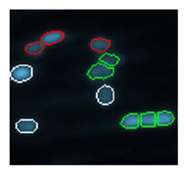
Cellular image analysis has a workflow
Image Analysis Step
Pre-Processing
Segmentation
Processing
Challenges
Low resolution
Uneven illumination
High noise
Separation of background from object of interest
Fused objects
Distinct cell types
Remove artifacts
Guo, Y. et al. An Image Processing Pipeline to Detect and Segment Nuclei in Muscle Fiber Microscopic Images (2014). Microscopy Research and Technique, 77, 546–559

Slide 20
Cellular image analysis has a workflow
Image Analysis Step
Pre-Processing
Segmentation
Processing
Analysis
Challenges
Low resolution
Uneven illumination
High noise
Separation of background from object of interest
Fused objects
Distinct cell types
Remove artifacts
Extract features to help answer research question

Slide 21
We prioritized the processing stage
Image Analysis Step
Pre-Processing
Segmentation
Processing
Analysis
Challenges
Low resolution
Uneven illumination
High noise
Separation of background from object of interest
Fused objects
Distinct cell types
Remove artifacts
Extract features to help answer research question
Notes:
Two reasons:
Many preprocessing methods
Masters student in the lab had some code in graph cuts and there was a really nice paper describing it

Slide 22
Exploratory Data Analysis

Slide 23
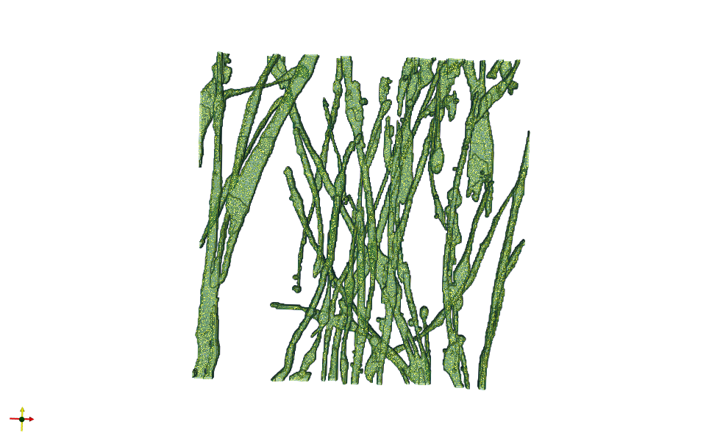
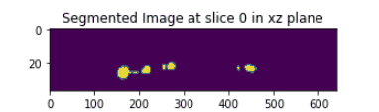
Image data exploration revealed a promising approach
Top view of binarized image

Slide 24

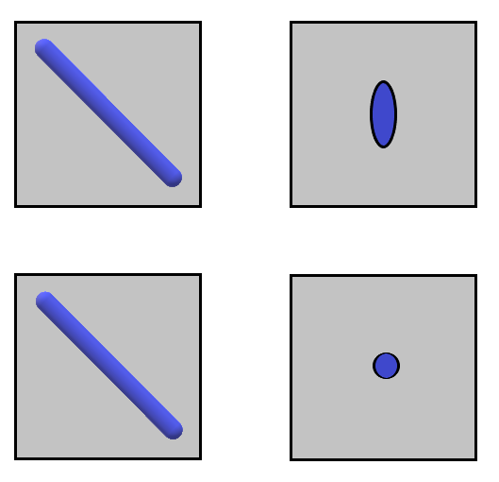
There were major issues that needed to be addressed
Notes:
Diameter would be inaccurate

Slide 25


How do we quantify irregular blobs?
Top view of binarized image
xz plane
Regular Blob
xz plane
y
Irregular Blob
x
Notes:
It’s important for two reasons:
We need regular blobs for diameter
Irregular blobs can indicate macro properties, like how clustered an image is

Slide 26
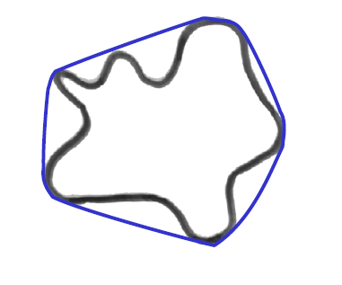
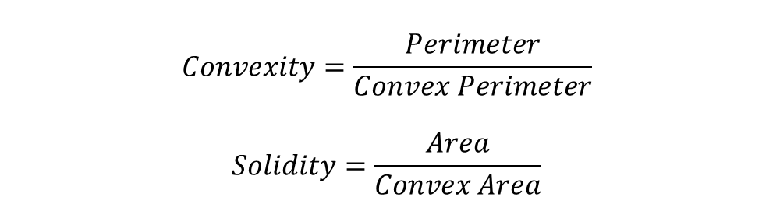
Geometric shape features can help indicate whether a blob is irregular
$$Convexity=\frac{Perimeter}{Convex Perimeter}$$
$$Solidity=\frac{Area}{Convex Area}$$
Convex hull

Slide 27
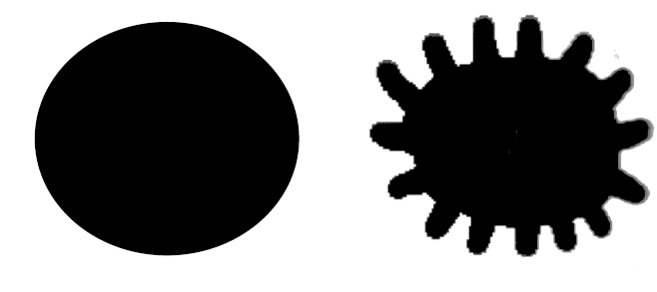
Geometric shape features can help indicate whether a blob is irregular
Regular blob
High convexity and solidity
Irregular blob
Low convexity and solidity
Convexity = 1
Solidity = 1
Convexity = 0.483
Solidity = 0.782

Slide 28
Shape features can help delineate between regular and irregular blobs
Top view of binarized image
xz plane
Solidity | 0.96
Convexity | 1.00
xz plane
Solidity | 0.53
Convexity | 0.77

Slide 29
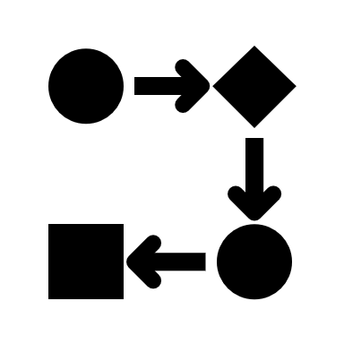
The OPlanaR Algorithm

Slide 30
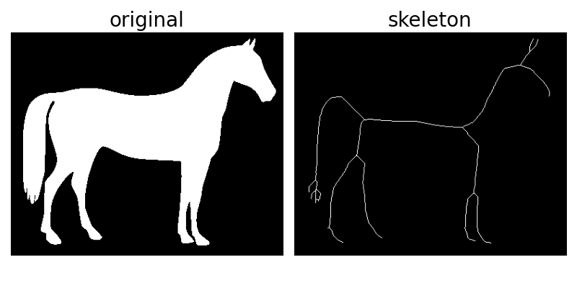
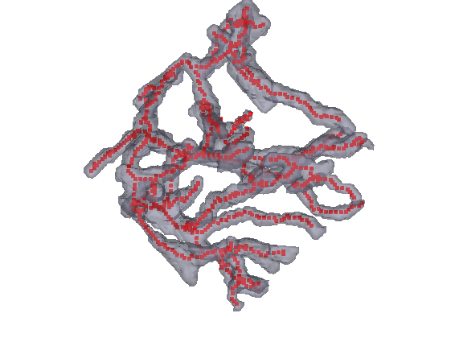
The OPlanaR Algorithm Step 1.1: Skeletonize the network

Slide 31
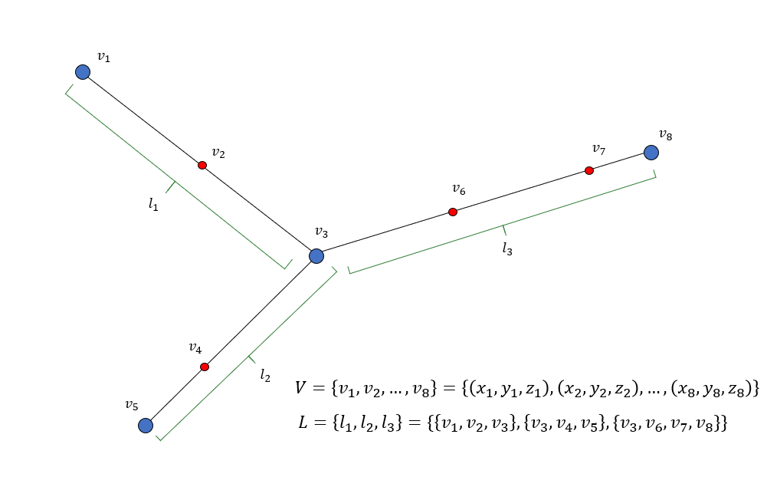
The OPlanaR Algorithm Step 1.2: Convert skeleton into graph

Slide 32
The OPlanaR Algorithm Step 1.2: Convert skeleton into graph
Link

Slide 33
The OPlanaR Algorithm Step 1.2: Convert skeleton into graph
Link
Terminal nodes

Slide 34
The OPlanaR Algorithm Step 1.2: Convert skeleton into graph
Link
Terminal nodes
Intermediate node

Slide 35
The OPlanaR Algorithm Step 1.2: Convert skeleton into graph
Link
Terminal nodes
Intermediate node
(x, y, z) coordinates

Slide 36
The OPlanaR Algorithm Result from Step 1.2
Notes:
This is for one link

Slide 37
The OPlanaR Algorithm Step 1.3: Smooth vertex coordinates using Gaussians

Slide 38
The OPlanaR Algorithm Step 2: Get tangent vectors for each node

Slide 39
The OPlanaR Algorithm Step 3*: Keep voxels with rMax
* This step is done iteratively for each node

Slide 40
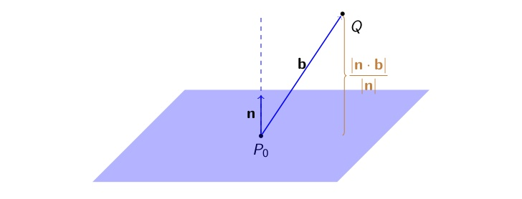
The OPlanaR Algorithm Step 4*: Project points in sphere onto tangent
* This step is done iteratively for each node
Notes:
Hammer home that the goal is to get an orthogonal cross section

Slide 41
The OPlanaR Algorithm Step 5*: Keep projected points within d2plane
d2plane
* This step is done iteratively for each node

Slide 42
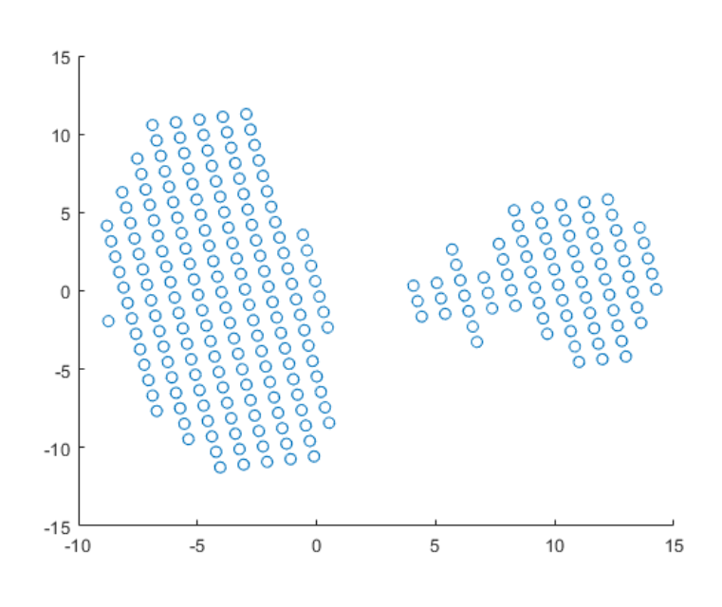
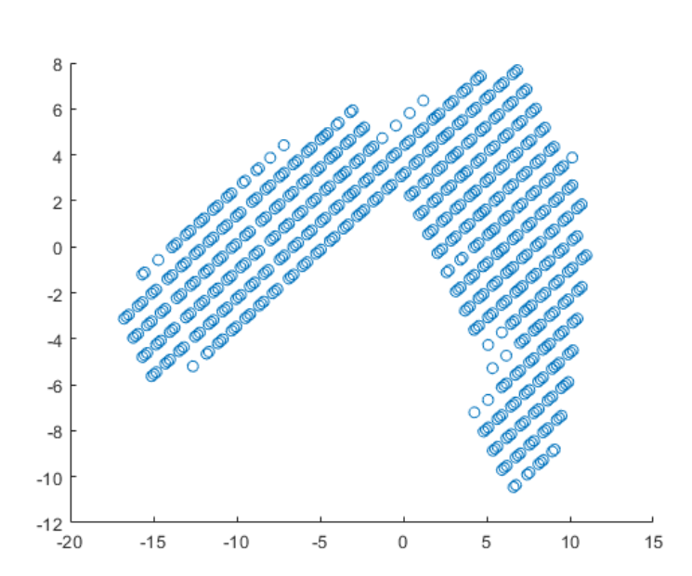
The OPlanaR Algorithm Step 6*: Take top 2 PCA components for retained points
* This step is done iteratively for each node

Slide 43
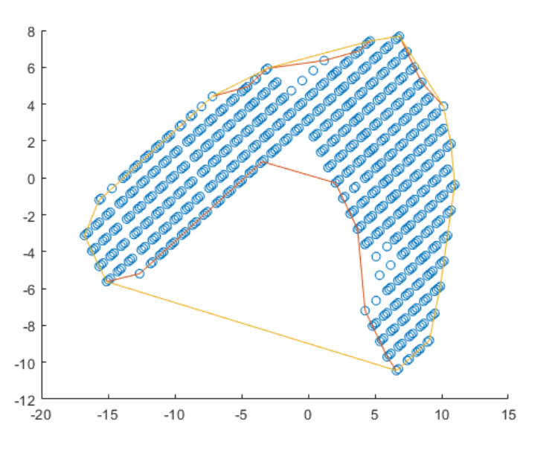
The OPlanaR Algorithm Step 7*: Determine outliers using shape features
Convexity threshold (tc) Solidity threshold (ts)
Convexity < tc
OR
Solidity < ts
True
False
Outlier
Inlier
OUTLIER
* This step is done iteratively for each node

Slide 44
Shape features can help delineate between regular and irregular blobs
Top view of binarized image
xz plane
Solidity | 0.96
Convexity | 1.00
xz plane
Solidity | 0.53
Convexity | 0.77

Slide 45
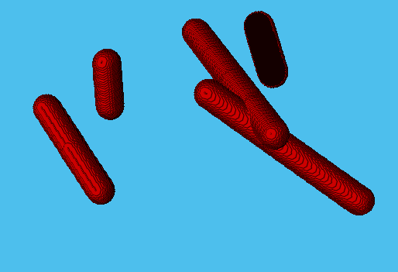
The algorithm was tested on artificially generated networks as proof-of-concept
# | Hyperparameter | Description | Choice
1 | rMax | Size of sphere | 20
2 | d2plane | Distance to plane | 1
3 | tc | Convexity threshold | 0.90
4 | ts | Solidity threshold | 0.90
5 | sigma | Gaussian standard deviation | 1
Ground Truth | Prediction (n=5) | Accuracy
30 | 31 ± 0.2 | ~96.7%

Slide 46
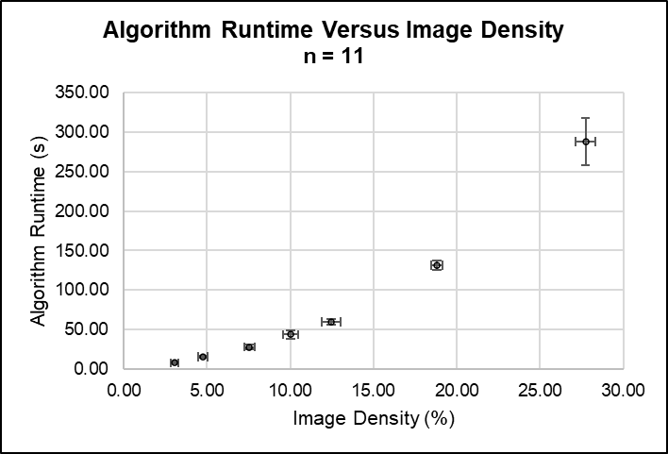
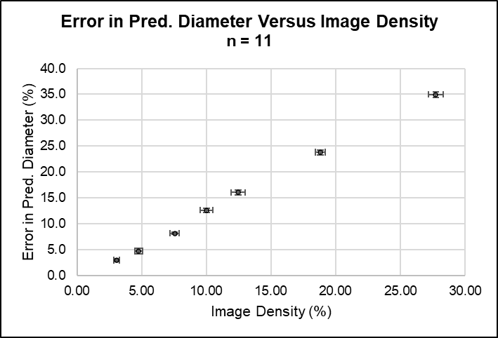
The model gets slower and less accurate as image density increases
Notes:
Image density was increased by increasing the number of rods

Slide 47
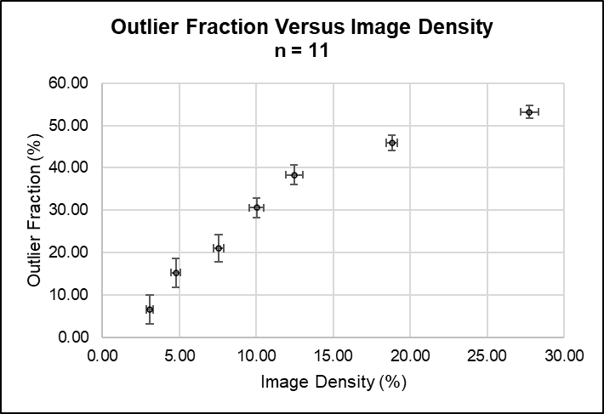
The model takes fewer samples as image density increases

Slide 48
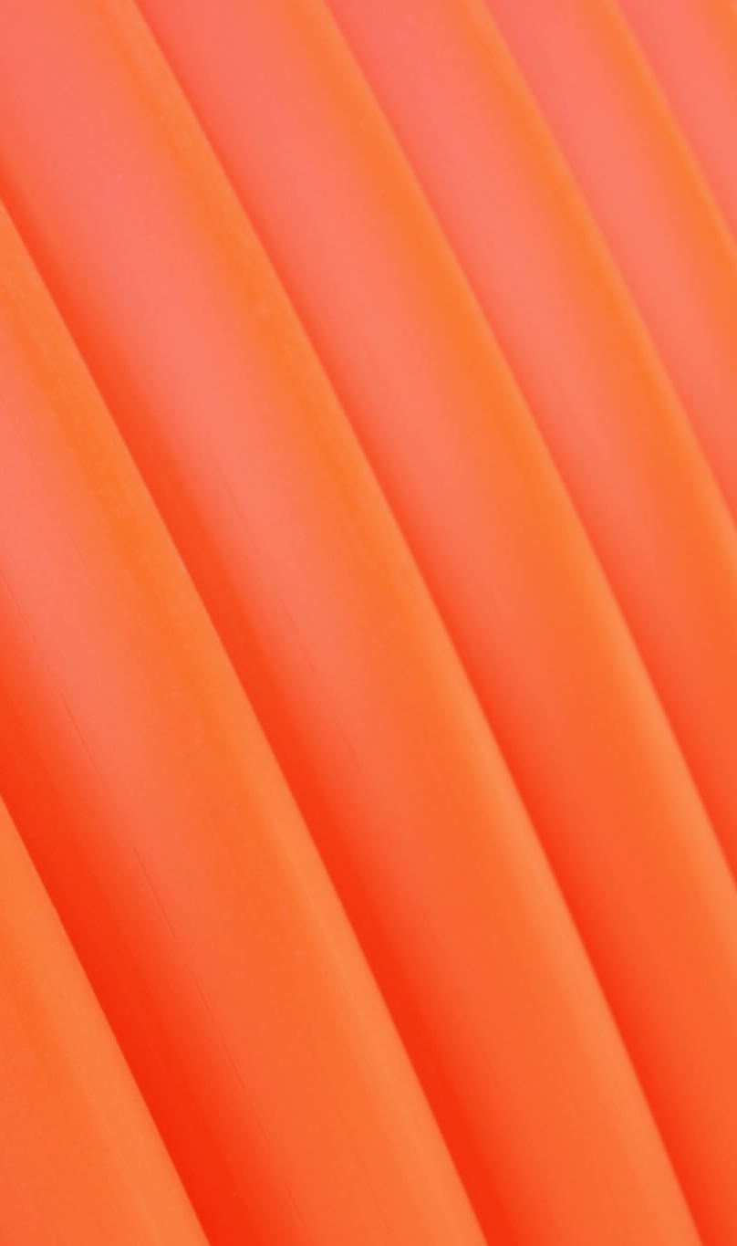
Image Analysis Pipeline

Slide 49
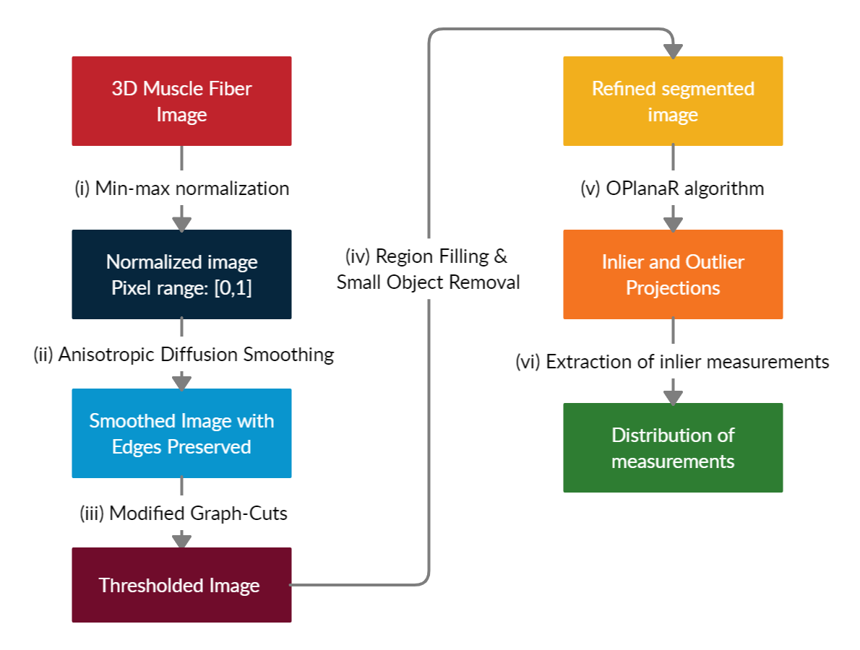
OPlanaR was implemented in an end-to-end image analysis pipeline

Slide 50
OPlanaR was implemented in an end-to-end image analysis pipeline

Slide 51
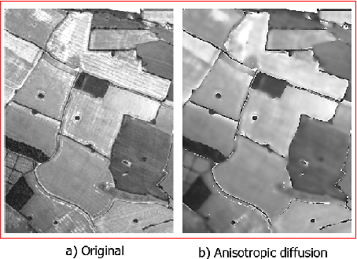
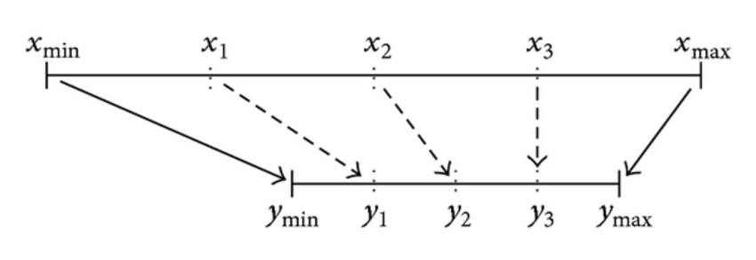
Min-max normalization and edge-preserving smoothing were used to preprocess
Min-max normalization: Squeezes pixel intensities to [0,1] range
Anisotropic diffusion smoothing: Blurs an image but maintains edges
Pal, C., Chakrabarti, A., Ghosh, R. A Bried Survey of Recent Edge-Preserving Smoothing Algorithms on Digital Images (2015). Procedia Computer Science, 00, 1–40

Slide 52
OPlanaR was implemented in an end-to-end image analysis pipeline

Slide 53
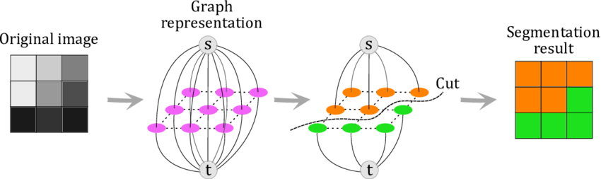
Graph cuts segmentation uses min-cut/max-flow algorithm to binarize an image
Gauriau, R. Shape-based approaches for fast multi-organ localization and segmentation in 3D medical images (2015). TELECOM ParisTech
Notes:
Major Challenges:
Fibers are unaligned
Fibers appear to be fused
Dearth of image work in 3D fiber networks
Minor Challenges:
Image artifacts
Background noise

Slide 54
Graph cuts segmentation uses min-cut/max-flow algorithm to binarize an image
Pixel-pixel
Foreground/Background
Gauriau, R. Shape-based approaches for fast multi-organ localization and segmentation in 3D medical images (2015). TELECOM ParisTech
Notes:
Major Challenges:
Fibers are unaligned
Fibers appear to be fused
Dearth of image work in 3D fiber networks
Minor Challenges:
Image artifacts
Background noise

Slide 55
Graph cuts segmentation uses min-cut/max-flow algorithm to binarize an image
Gauriau, R. Shape-based approaches for fast multi-organ localization and segmentation in 3D medical images (2015). TELECOM ParisTech
Notes:
Major Challenges:
Fibers are unaligned
Fibers appear to be fused
Dearth of image work in 3D fiber networks
Minor Challenges:
Image artifacts
Background noise

Slide 56
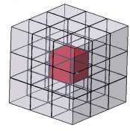
A 26-connected image graph was generated with source and sink nodes
26-connectivity

Slide 57
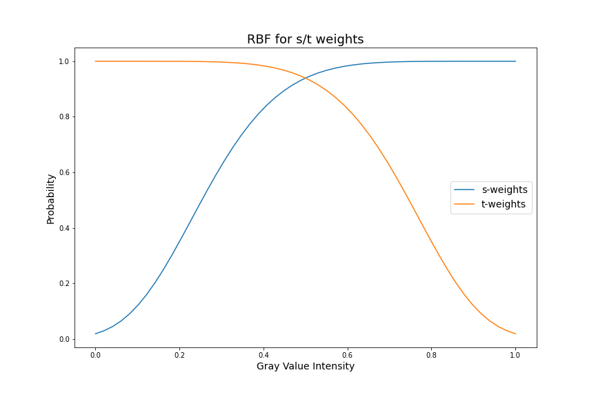
A 26-connected image graph was generated with source and sink nodes
26-connectivity
s/t weights

Slide 58
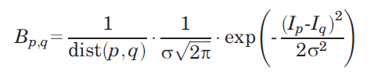
A 26-connected image graph was generated with source and sink nodes
pixel-pixel weights
26-connectivity
s/t weights

Slide 59
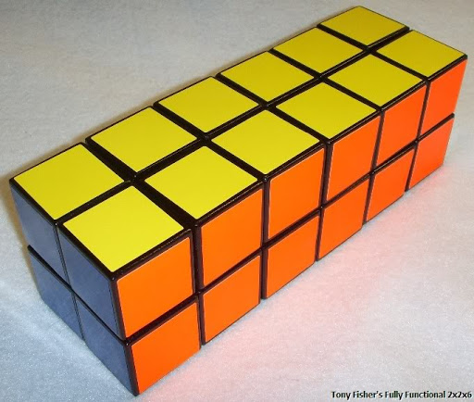
Image was split into 16 and operated on separately

Slide 60


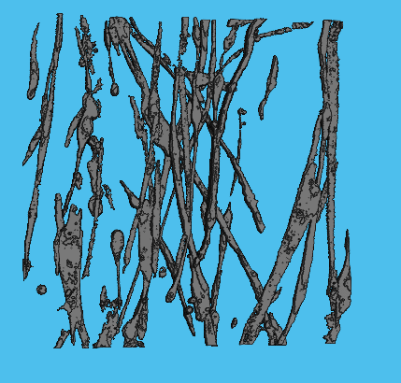
Results
Original
Preprocessing
Binarized

Slide 61
OPlanaR was implemented in an end-to-end image analysis pipeline

Slide 62
OPlanaR was implemented in an end-to-end image analysis pipeline

Slide 63
OPlanaR was implemented in an end-to-end image analysis pipeline

Slide 64
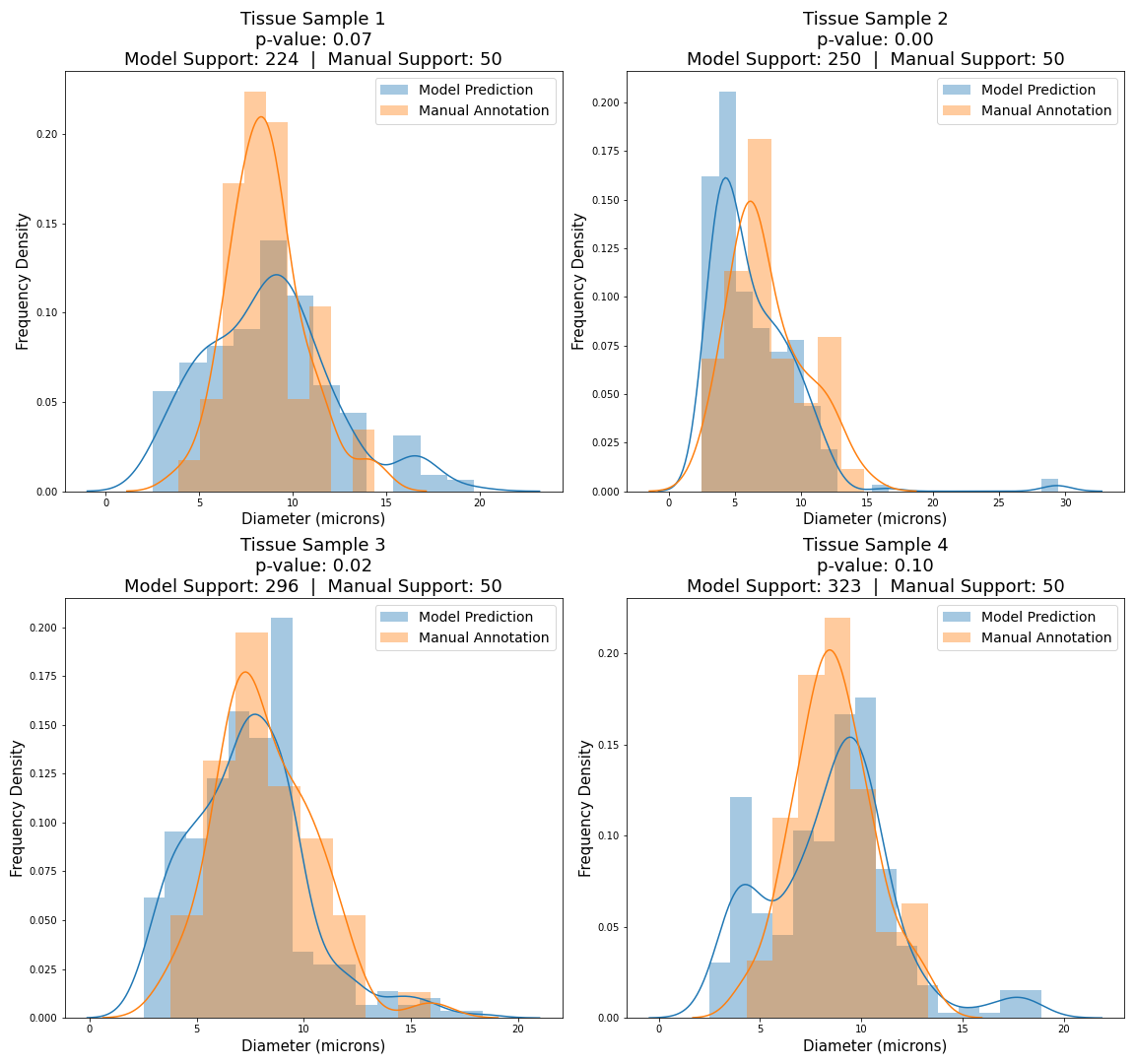
4 manually annotated MEndR images were used to validate model performance
Average deviation between means 6.5%
Kolmogorov-Smirnoff statistical test
2 distributions are similar
2 distributions are not

Slide 65
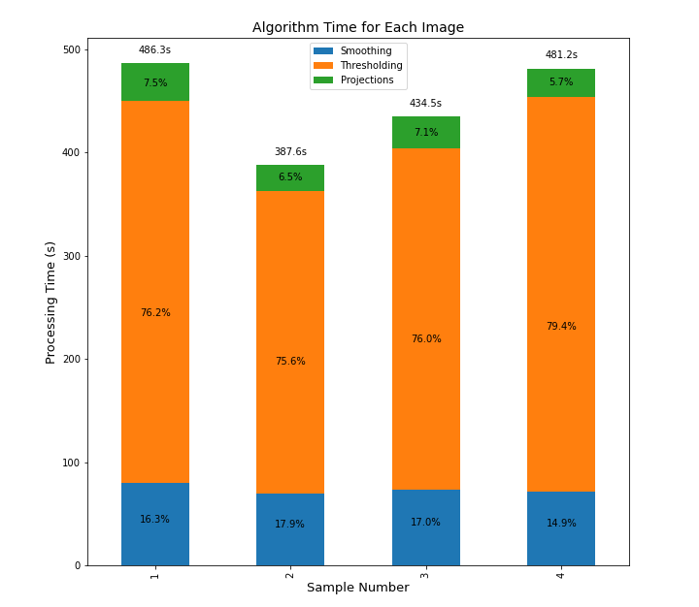
The pipeline is also much faster than manual annotation
Time per sample (s) | 1.7
Stage | % of pipeline runtime
Smoothing | 16.5
Binarization | 76.8
OPlanaR | 6.7

Slide 66
The pipeline is also much faster than manual annotation
9-17X faster!
Time per sample (s) | 1.7
Stage | % of pipeline runtime
Smoothing | 16.5
Binarization | 76.8
OPlanaR | 6.7

Slide 67
The pipeline is also much faster than manual annotation
9-17X faster!
Time per sample (s) | 1.7
Stage | % of pipeline runtime
Smoothing | 16.5
Binarization | 76.8
OPlanaR | 6.7
Binarization is very slow

Slide 68
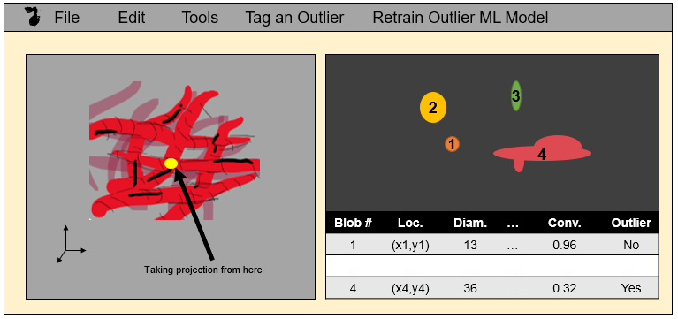
Limitations and Future Work
Low density images (1.15%)
Speed up graph cuts (CNNs, parallelization)
Better artificial networks
Tailored skeletonization
Use ML for outlier detection
GUI for interpretability

Slide 69
Conclusion
OPlanaR and image analysis pipeline are promising methods!
Much faster than human annotation
They extend beyond diameter and muscle fiber images
Takes us one step closer to discovering new therapeutics that enhance muscle health through MEndR

Slide 70
Acknowledgements
Professor Alison McGuigan, for allowing me to work on this project, for teaching me how to formulate a research question, and how to communicate effectively
Jose Cadavid & Amir Meysami Fard, for mentoring and supporting me during this entire project
Nancy Li, for teaching me how to navigate the research space
Vera Pieters and Vincenzo Ferrulli, for supporting me mentally
The other members of the McGuigan Lab: Simon, Nila, Ileana, Michael, and Natalie, for welcoming me and inspiring me

